Slide 1
Note to Presenters
It would be quite difficult to get through all of the slides and activities included here during your presentation
Most presenters will want to trim it down to suit their expected audience and personal presentation style.
The speaker notes attached to the slides include descriptions of the activities we have planned, along with an estimate for the amount of time required for those activities.
You will also want to add a slide or two near the end to explain how to sign up for DI.

Slide 2
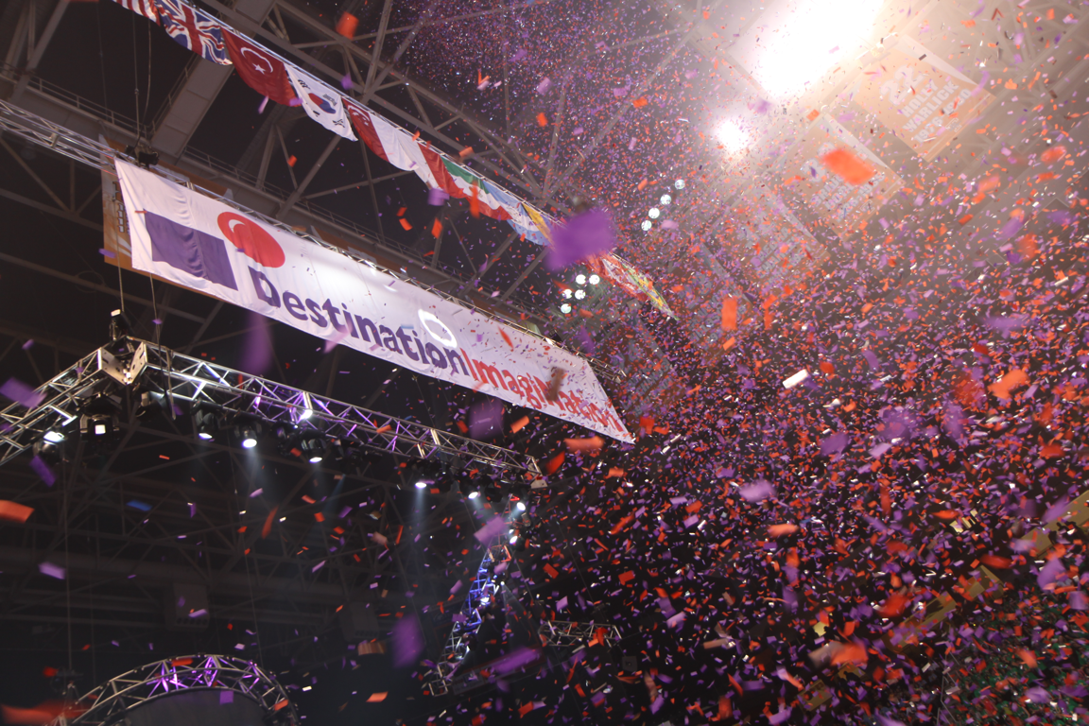
Introduction to Destination Imagination
W
E
L
C
O
M
E

Slide 3
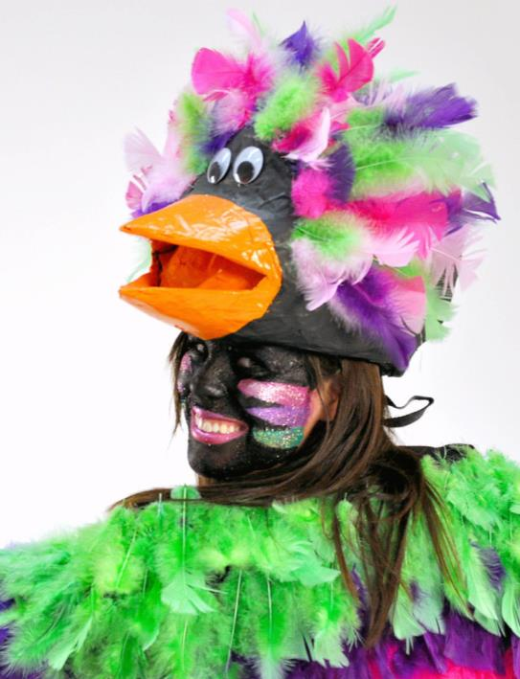
Imagine…
Imagine an educational activity for student teams in which:
They build confidence while learning.
Discovery is the only teacher as they solve open-ended challenges.
They develop life-long critical thinking and problem solving skills.
W
E
L
C
O
M
E
Notes:
Imagine a program where students…
Become confident
Learning is via exploration rather than direction
Students develop lifelong, vital skills in creative thinking and solving their own problems.

Slide 4
Destination Imagination
World’s largest organization devoted to turning students into world-class innovators
Team-based creativity education program with participants from over 30 countries
Programs for students of all ages from kindergarten through college
More than 1.5 million alumni
Notes:
Creativity is not typically taught in schools alongside reading, math, and science.
Perhaps it could be, but until that time, many schools do provide it through afterschool programs.
The world’s largest program of this kind is Destination Imagination. Our goal is to turn students into world-class problem solvers and innovators, and we’re very good at it.
DI is a non-profit, international program in which students work in small teams that typically have 5 to 7 members. We have teams from all over the United States, and from more than 30 other countries.
There are programs for students of all ages, from kindergarten through college.
Since its inception, Destination Imagination has taught more than 1.5 million students how to be more creative, how to manage a long-term project, and how to work effectively within a team—which means that they have acquired long-term skills that will be useful throughout their careers.

Slide 5
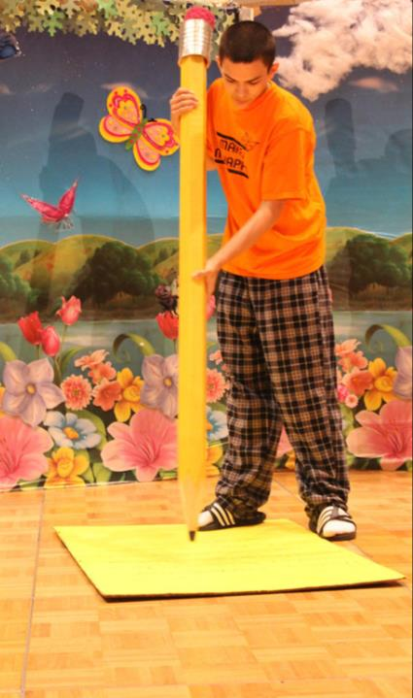
The Creative Process
Destination Imagination teaches the creative process from imagination to innovation.
© 2009 Destination ImagiNation, Inc.
Notes:
We use inquiry guided group learning – students are put on teams and given an open-ended question to solve, and they must solve their own challenge from there.
We teach Idea-creation and direction tools are included as one component of teaching the creative process
We try not to emphasize the competitive aspects of DI
5

Slide 6
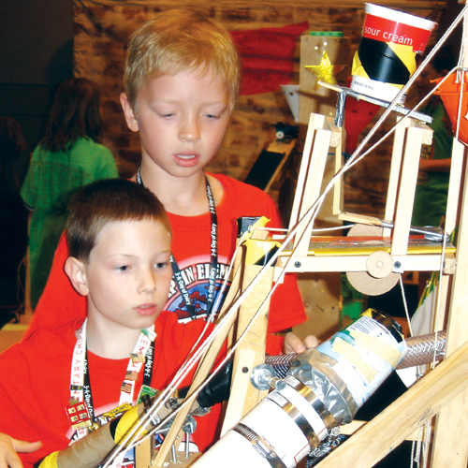
The Creative Process
Research has shown that creativity is something that students can learn
Creativity is an important key to future success
Creativity leads to Innovation
© 2009 Destination ImagiNation, Inc.
Notes:
As we mentioned earlier, Destination Imagination works by teaching the creative process.
Why do we think this is important? Because creativity has been shown to predict future success, and because this is something that students can learn. Creativity isn’t something that you simply have to be born with! Anyone can learn to be more creative.
6

Slide 7
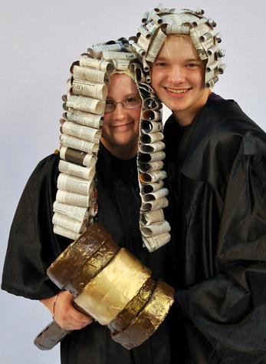
DI Teaches…
We enable students to access their creativity, learn how to work as a team, and gain experience in solving problems.
We teach the skills that colleges and employers are looking for.
© 2009 Destination ImagiNation, Inc.
Notes:
DI is an enabling program. We help students learn that they can be creative, solve complex problems, and work on a team: all skills that apply to today’s college and career readiness standards.
7

Slide 8
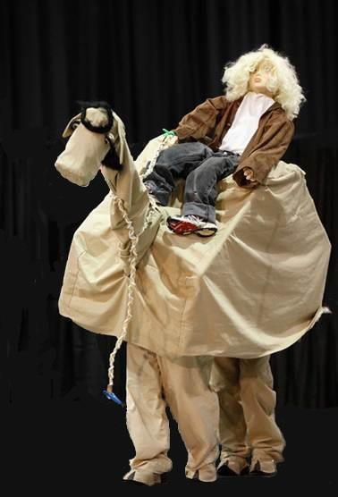
DI Students…
Have FUN!
Think critically and creatively
Work together to achieve goals
Listen, evaluate, and build upon teammate ideas
Manage their time
Have even more FUN!
© 2009 Destination ImagiNation, Inc.
Notes:
As we mentioned earlier, Destination Imagination works by teaching the creative process.
Why do we think this is important? Because creativity has been shown to predict future success, and because this is something that students can learn. Creativity isn’t something that you simply have to be born with! Anyone can learn to be more creative.
8

Slide 9
Student-Driven
Team members direct their learning
Team members develop their solution from research to presentation
Adults can teach skills and process, but cannot direct the solution
Team members have room…to risk, to fail, and ultimately to learn
Notes:
We learn more by what we discover ourselves. The beauty of DI – what makes us unique – is our strict adherence to rules about what adults can – and cannot – do for the kids.
We can teach them to use the scientific method and apply creativity tools to generate, focus, and evaluate their ideas, but we cannot give them the ideas.
Kids must do their own work; we can teach them to use a jigsaw but we cannot make the cuts for them. We can teach them to sew but we cannot sew that costume for them. We can help them learn to research but we cannot tell them what to research.
We give them room to risk, to fail, and to learn by experience what works and what doesn’t. And that is the best teacher of all, and NOTHING is more satisfying to a team than the knowledge that they did it themselves!

Slide 10
Destination Imagination
Introductory video would go here.
We didn’t embed the video within this file because:
Only the most recent versions of PowerPoint are capable of embedding a video within a PPTX file
Links to separately stored videos tend to break very easily in older versions of PowerPoint
There are lots of different DI videos of various lengths that you could use here, so we thought you’d prefer to choose the one you like best!
Please contact NH-DI if you have trouble finding something that would be suitable
Notes:
Here you would embed an introductory video. You’ll find various examples at destinationimagination.org and nh-di.org.
Please contact NH-DI if you can’t find something suitable, or you could simply skip this slide and proceed directly to the detailed description of the program.

Slide 11
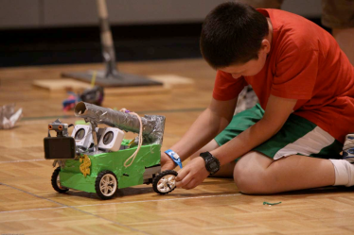
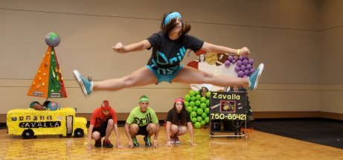
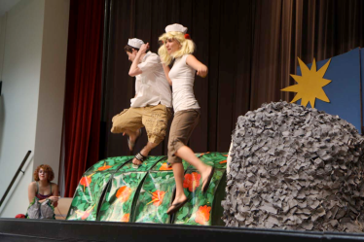
The DI Equation
Team
Challenge
+
Instant
Challenge
These are the components that make up the DI program.
Notes:
Introduce briefly the concept of the Team Challenge and Instant challenge.
Then transition into what the Team Challenges are, and explain that they have been given a handout with each Team Challenge described in more detail.

Slide 12
Imagination to Innovation
Over the course of a season, students will:
Generate and incubate ideas, research and make inquiries
Focus, prepare for action, put together solutions
Build teams and learn new skills
Prepare for the tournaments
Celebrate their successes!
Notes:
You may have heard that doing DI takes a lot of time, but let’s look at what a “typical season” might look like.
(briefly mention each of the steps listed here)

Slide 13
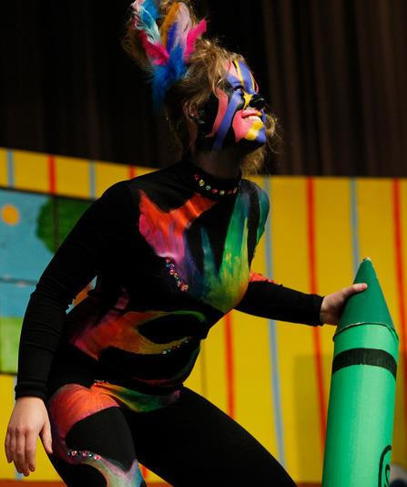
Team Challenge
Team Challenges take weeks or months to solve and have specific focuses.
The Team Challenges are new and different every year.
Notes:
There is really no “typical” season. The amount of time required varies greatly, depending on how much time the team members have available to devote to DI. Some teams get into DI in a big way, and want to spend lots of time working on their Team Challenge.
Other teams just want to have fun together, and spend a minimal amount of time on their solution. The Team Challenges are generally designed to allow simple solutions, although these usually won’t receive a high score.
It’s usually possible to work around other activities. When a team includes members with other commitments, they can agree among themselves to limit the amount of work that’s assigned to those team members.
Imagine someone who has a major role in a school play. At first, the cast will meet once or twice a week for a few hours. This usually changes during the week or two before the first performance. It’s important to run through the entire play, so the meetings get longer and become more frequent.
The time commitment for DI is very similar. At first, teams will typically meet once a week for a few hours. However, as the date approaches for the tournament, teams usually find that they will need to schedule extra meetings in order to complete their solution on time. During the week before the tournament, the team will usually spend most of their spare time getting everything ready, and rehearsing their performance.

Slide 14
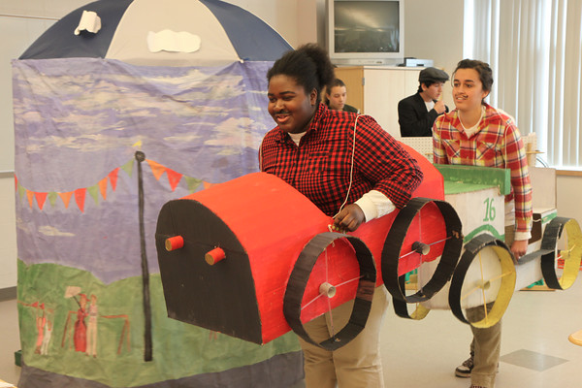
Technical: Creature Feature
Students complete tasks by using engineering, research, strategic planning and related skills.
Build a creature that uses technical methods to perform team-chosen actions.
Present a story of adventure with the creature as a character.
Use technical methods to demonstrate features of a world where the story is set.
Notes:
Explain that the next few slides show this year’s challenges. Each challenge has focus on a general area such as science or engineering, but all of the challenges share elements such as telling a story with a specific theme, meeting specifications, and applying the team’s creativity.
Then briefly describe each of this year’s challenges.

Slide 15
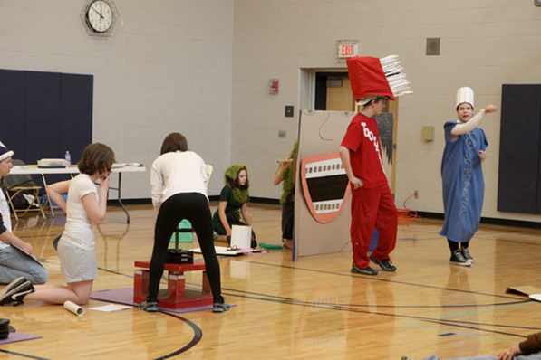
Structural: Lose to Win
Design, build and test load-bearing structures out of specific materials and against specific forces.
Design and build a structure that can continue to support weight as parts of the structure are removed.
Tell a story about how something is transformed and revealed to be something completely different.
Create a prop or set piece that transforms as parts are removed.

Slide 16
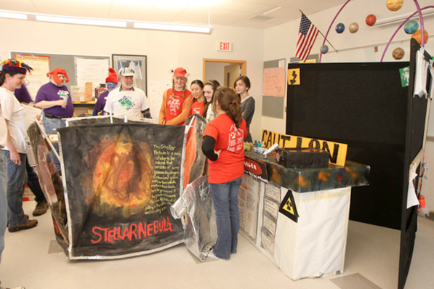
Scientific: Making Waves
Blends the research and curiosity of science with the thrill and creativity of the theater arts.
Design and construct an incredible sound machine that produces two different sounds.
Create and integrate two visible displays of sound waves into the presentation.
Create and present a story that includes a change to a faster or slower narrative pace.

Slide 17
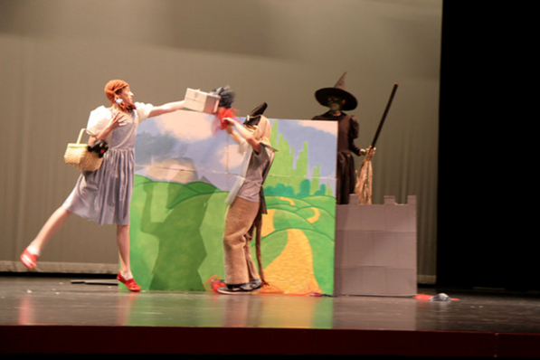
Fine Arts: Feary Tales
Students flex their acting and artistic muscles as they explore some of our most fascinating works of literature and media.
Present a team-created fairy tale about a character that faces and deals with a phobia.
Create an expressive artwork that conveys a thought or feeling.
Create a functional artwork that serves a practical function.
Design and create an illusion that makes the impossible seem possible.

Slide 18
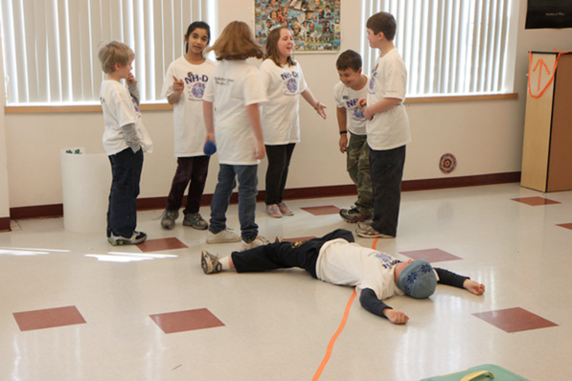
Improv: The Improv Games
All about spontaneity and story-telling, teams receive topics and produce skits right on the spot.
Create three independent improvisational sketches.
Research and incorporate improvisational games and street performances.
Practice integrating randomly selected situations and settings.

Slide 19
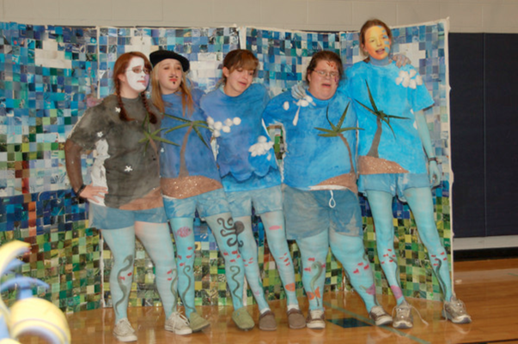
Project OUTREACH: Brand Aid
Engage students in community service to address real community issues through personal expression.
Use the creative process to identify, design, and carry out a project to address a real community need.
Use graphic arts and sounds to create an effective brand to help meet the project goal(s).
Create a live presentation that highlights the project and project evaluation.
Design and create a project puzzle to put together during the presentation.

Slide 20
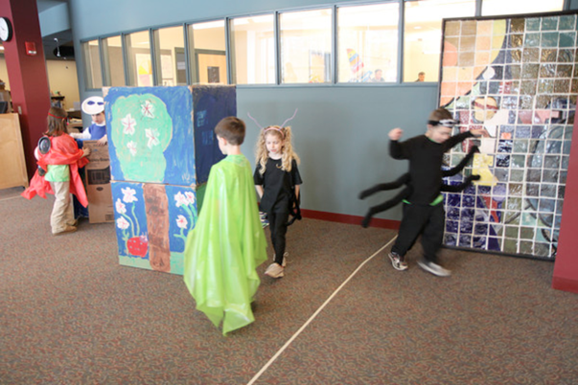
Rising Stars!®: Animal Mish Mash
For early learners. 4- to 7-year-old children work together on performances complete with characters, props and scripts.
Learn about animals and their habitats.
Design a new animal, and construct the animal and its habitat in 3-D, including moving parts on both.
Create a play about the movements your new animal makes, and the adjustment that your new animal makes in its new habitat.

Slide 21
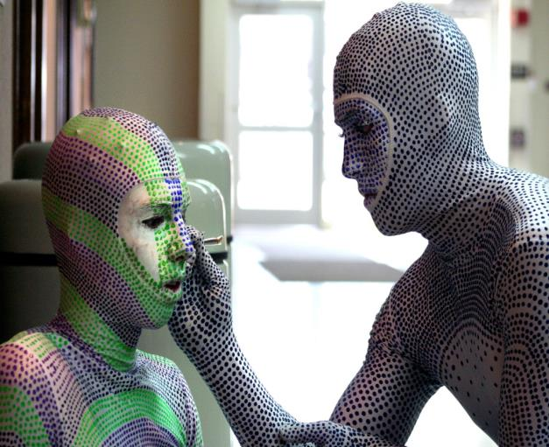
Team Choice Element
In all except the improvisational challenge, teams create and present two Team Choice Elements that show off the team’s unique interests, skills, areas of strength, and talents.
Notes:
Say – could be solo, a particular costume or element of a skit, a technical innovation.. The team chooses! The idea is that teams have the chance to emphasize something they are good at or of which they are particularly proud.

Slide 22
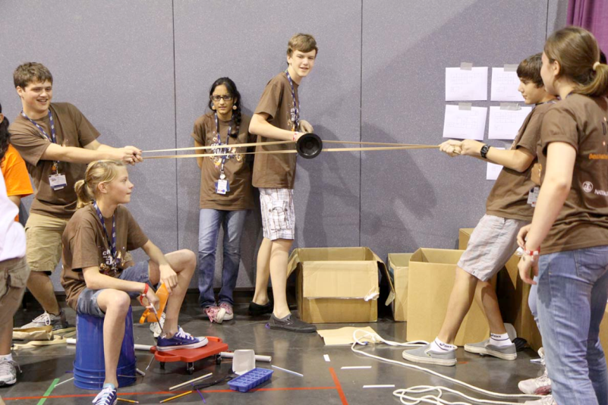
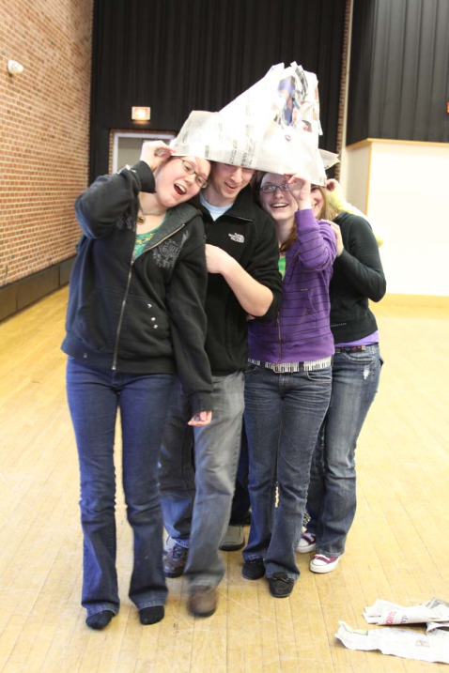
Instant Challenge
A test of teamwork and the ability to think on your feet...
Notes:
Explain IC and introduce the quick IC activity

Slide 23
Instant Challenge
Challenge: Stack cups using a rubber band and strings
Everyone must be holding a string at all times
Only the rubber band may touch the cups
You will have 6 minutes to create a pyramid of cups
Scoring:
50 points if you can create a 10-cup pyramid
75 points if you can create a 15-cup pyramid
0 points if the pyramid is not complete
Notes:
Strings Attached
SETUP:
Rubber band with strings attached to it (you can do it with a rubber band and, say, 6 or 8 strings – depends on how many people you want crowded around a single area. I’d go with 7 to a team (max number of DI kids)…
15 cups to a table (mix up the cups so some are up and some are down)

Slide 24
Instant Challenge
Challenge: Your team has been asked to create the ribbon for a ribbon-cutting ceremony, but all you have is a piece of paper. Your task is to make the paper as LONG as possible.
Time: You will have one minute to brainstorm solutions, without modifying the paper during this time, and then one minute to execute your plan.
Scoring:
One point (60 maximum) for each inch of length.
Up to 20 points for the creativity of your solution
Up to 20 points for how well your team works together
Notes:
Do a debrief after, how could they have done better

Slide 25
What Does DI Teach?
Written and oral communication
Presentation skills
Teamwork and collaboration
Research skills
Creative Thinking: generating original ideas
Critical Thinking: Evaluation, planning
Project and time management
Notes:
This is what we teach… (point out each of the items)
So how do these educational goals match up with what companies are looking for when they select employees? (next slide)

Slide 26
Educational Standards
Each year, Destination Imagination publishes “Connecting the Standards”
This describes exactly how each Team Challenge relates to:
  National Educational Standards
  Common Core
  STEM

Slide 27
What Experts Say About DI
“We can’t teach our children everything that they need to know, but Destination Imagination provides opportunities for them to think, take risks, and work together to solve common problems—traits that will get them to rule the world.”
Raymond Simon, Deputy Secretary
U.S. Department of Education
Notes:
What do the experts have to say about DI?
Here’s a quote from the Raymond Simon, the Deputy Secretary of Education. DI teaches the skills that students need to be the leaders and innovators of the future.

Slide 28
What Kids Say About DI
Team-created video would go here.
We didn’t embed the video within this file because:
Only the most recent versions of PowerPoint are capable of embedding a video within a PPTX file
Links to separately stored videos tend to break very easily in older versions of PowerPoint
There are lots of different DI videos of various lengths that you could use here, so we thought you’d prefer to choose the one you like best!
Please contact NH-DI if you have trouble finding something that would be suitable
Notes:
You’ll find lots of team-created videos at sites like YouTube. Please contact NH-DI if you can’t find something suitable.
If you’d rather not use a video, you could skip this slide, and include only the written participant endorsements that follow.

Slide 29
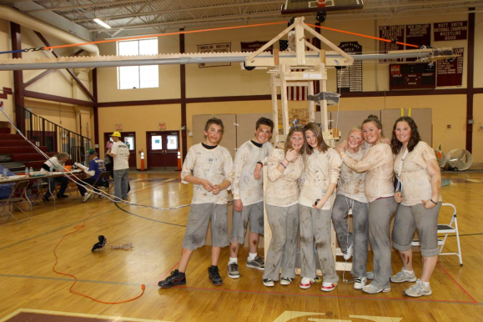
Participant Testimonials...
“Nothing else has been such a driving and permanent force as DI. Nothing has driven me to succeed as much like DI. Nothing has driven me to find new and exciting ways to solve problems like DI. Nothing, and I truly mean nothing, has taught me how to work within a team, within a budget, and within a set time, like DI.”
- Michael Russell (Alumnus)

Slide 30

Participant Testimonials...
“I can’t begin to name the gifts DI has given me. Not only am I armed with lifelong critical skills and surrounded by teammates who became family, I have a confidence that runs deep in my core. No matter what obstacles lay in our path or even what walls we may hit, that confidence instilled at such a young age cannot be shaken.”
- Cass Mercer (Alumna)

Slide 31
We Can’t Do This Without You
We need Team Managers!
Many schools have to turn students away because there are not enough places available on DI teams
Please consider volunteering…
Notes:
Explain that at most schools, more students want to do DI than there are places on existing teams.
Many more students could have this opportunity if more adults were willing to be a Team Manager, which is what we call the adult (or adults) who supervise each DI team.

Slide 32
The Kids Need You!
Team Manager recruitment video would go here.
We didn’t embed the video within this file because:
Only the most recent versions of PowerPoint are capable of embedding a video within a PPTX file
Links to separately stored videos tend to break very easily in older versions of PowerPoint
There are lots of different DI videos of various lengths that you could use here, so we thought you’d prefer to choose the one you like best!
Please contact NH-DI if you have trouble finding something that would be suitable
Notes:
You’ll find Team Manager recruitment videos at sites like YouTube. Please contact NH-DI if you can’t find something suitable.
If you’d rather not use a video, you could simply skip this slide.

Slide 33
We Can’t Do It Without You!
You do not have to be especially creative or talented to manage a DI team!
Patience is the most important requirement
NH-DI will help you with training, mentors, online materials, and other resources
Notes:
You don’t have to be creative to manage a team! Patience is the most important requirement.
Destination Imagination and NH-DI can provide training, mentors, and great materials to get you going!

Slide 34
Volunteer Testimonial...
“Being a team manager has made me a better parent and a teacher. I understand deeply the value of facilitating my children—and my students—to find their own solutions.
I know how to guide them through the process of solving a problem rather than just giving them an answer. As a result of DI, I understand the value of struggling with a tough problem as the most effective way for children to learn, and I know how to teach them to embrace the struggle rather than give up too quickly. The reward is being there at that profound moment when children see an idea come to fruition and know that they did it by themselves.”
- Carrie Thompson (Team Manager)

Slide 35
Still Thinking About It?
Visit the NH-DI website (nh-di.org) for more information, or just call us!
Go to NH-DI’s workshop for new Team Managers before you decide
This is a job that you can share with other parents

Slide 36
Common Roadblocks
Caregiver for other young children who aren’t on the team
Full-time job makes it impossible to meet after school
Wouldn’t know where to begin!
Not enough free time for this
Notes:
Other parents might be willing to help with childcare.
Teams are not required to meet after school. Sometimes weekends or evenings work better for all concerned.
How many parents are Boy Scout or Girl Scout leaders? The weekly time commitment for DI is comparable, BUT it isn’t for the entire year.
How many parents coach an athletic team? The DI season is longer, but athletic teams often have practices several times each week.

Slide 37
If You Can’t Manage a Team…
Help NH-DI run local DI tournaments
  Tournament officials (Appraisers)
  Volunteers (concessions, information)
Help your child’s Team Manager!
  Provide transportation or a place to meet
  Bring snacks for the team
  Families could take turns at providing an extra pair of hands at meetings
Notes:
If you really can’t manage a team, there are many other ways to help!
If you simply can’t manage a team, there are many other volunteer opportunities.
We need tournament officials and volunteers, and every Team Manager could use a little extra help from their parents.

Slide 38

Q&A
Notes:
5 minutes max for questions, let them know you will be available after for additional questions.

Slide 39
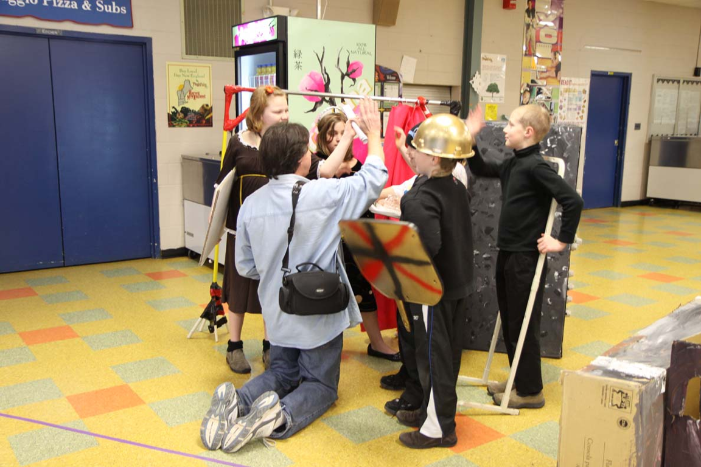
Instant Challenge
With Kids and Adults
Notes:
This optional activity is meant to take place after the kids return to the room. At most DI nights, we try to send the kids to another room during the presentation. They can have some fun trying simple Instant Challenges while we talk to their parents.
For this Instant Challenge, only the kids can touch the materials and produce the solution.
The adults can talk, but they are only allowed to ask questions.

Slide 40
Instant Challenge
During the presentation to parents, we usually use Instant Challenges to entertain the kids in another room.
If time permits, we sometimes have a final Instant Challenge after the kids have returned. We ask parents to watch as their children work on the Instant Challenge.

Slide 41
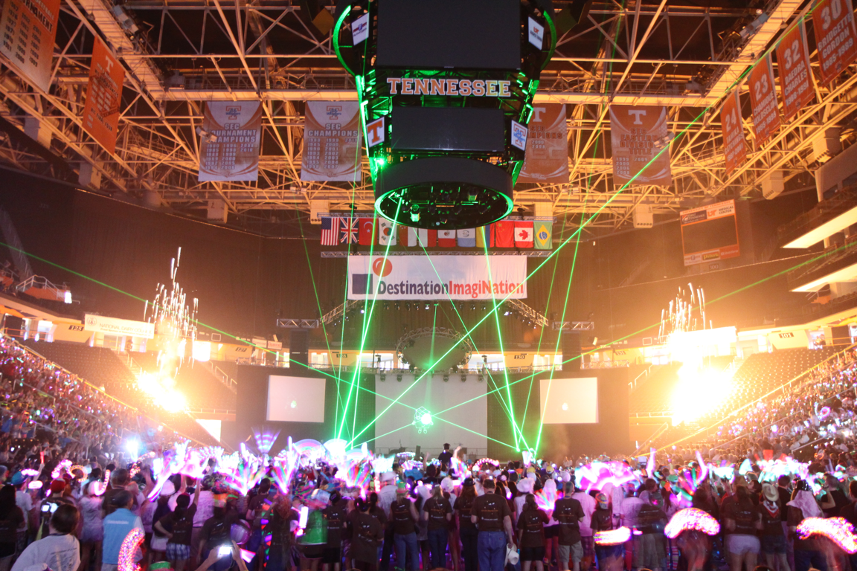
THANK YOU!

